Slide 1
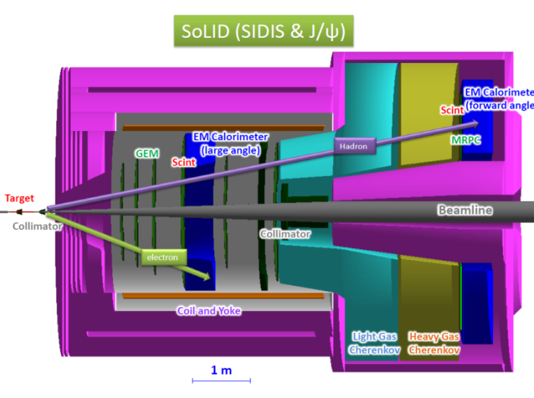
SoLID-SIDIS: Future Study of Transverse Spin, TMDs and more
Zhihong Ye
Duke University & SoLID Collaboration
DIS Workshop @ SMU, Dallas, TX
04/30/2015

Slide 2
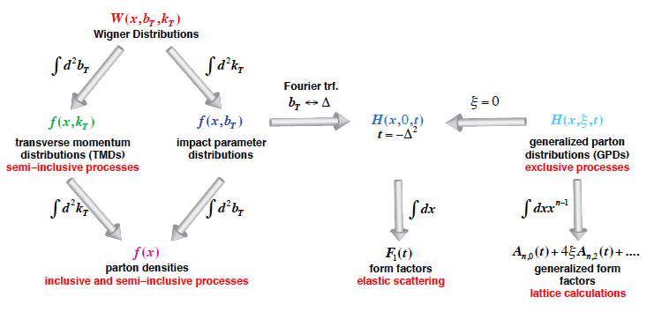
Unified View of Nucleon Structure
Wigner distributions (Belitsky, Ji, Yuan) (or GTMDs)
5D
(X. Ji, D. Mueller, A. Radyushkin)
3D
1D

Slide 3
Outline
Transverse Spin and TMDs
Probe TMDs with SIDIS
6GeV SIDIS Results
SoLID-SIDIS @ 11GeV
GPD Study via DVCS with SoLID
Summary

Slide 4
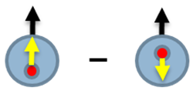
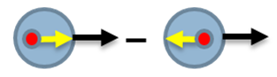
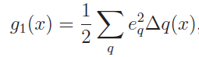
Transverse Spin
Difference between ∆q and h₁(x)
Non-relativistic
Relativistic: Lorentz boost and rotation don’t commute
Imply the relativistic nature of the nucleon spin structure
Exist of orbital angular momentum of quarks
Hard to access in Inclusive DIS process: g₂ ~ (m_{q}/M)h₁(x) + … OPE
Can be accessed in semi-inclusive DIS (SIDIS)
Interesting features:
Valence-like behavior
Soffer’s inequality: |h₁(x)| < ½(f(x) +∆q(x))
Chiral-odd nature etc.
h₁(x)= q→(x) – q←(x), Transversity
∆q=q↑(x) - q↓(x), Helicity
=

Slide 5
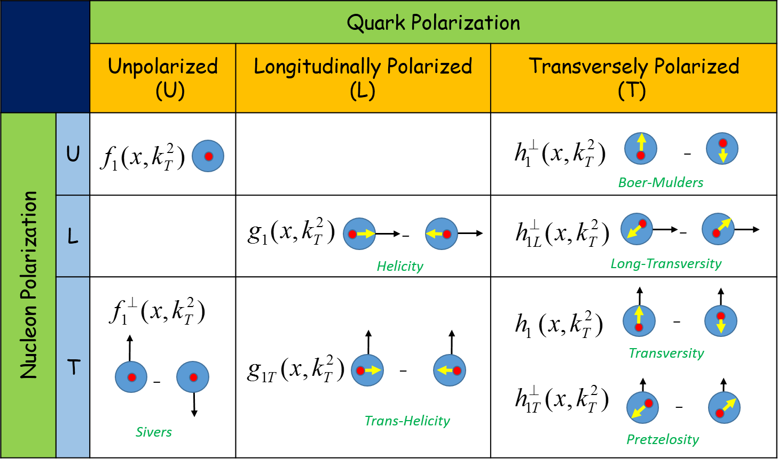
TMDs
Leading-Twist TMDs
8 TMDs with different polarization direction of nucleons and quarks

Slide 6
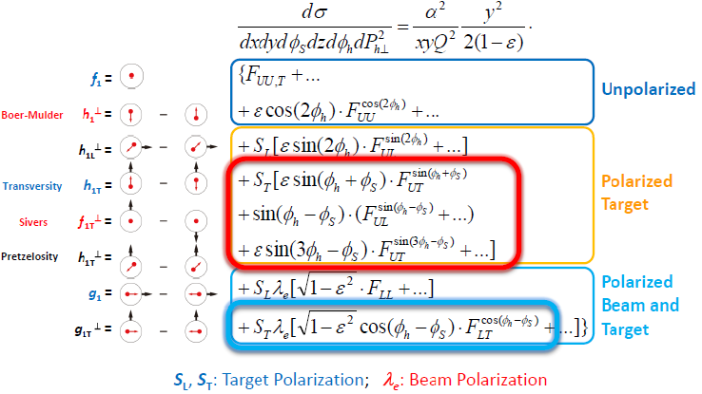
Probe TMDs with SIDIS
TMDs can be assessed SSA/DSA in SIDIS process

Slide 7
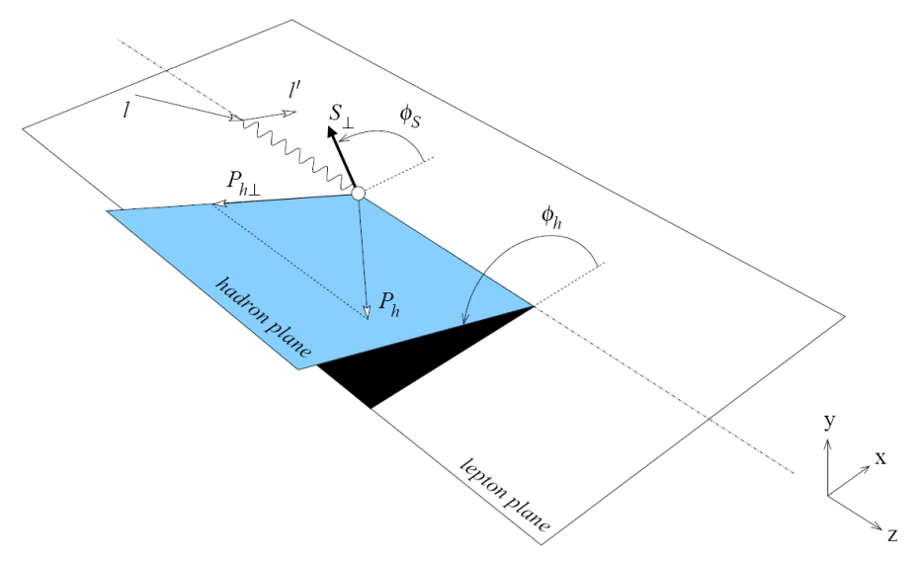
Probe TMDs with SIDIS
Transversely polarized target Single Spin Asymmetry (SSA):
Separation of Collins, Sivers and pretzelosity effects
through azimuthal angular dependence:
UT: Unpolarized beam + Transversely polarized target
Transversity
Sivers
+Fragmentation Functions
Prezelosity
Double-Spin Asymmetry (DSA). e.g.:
Fragmentation functions can be obtained from (e+,e-) data
Worm-Gear

Slide 8
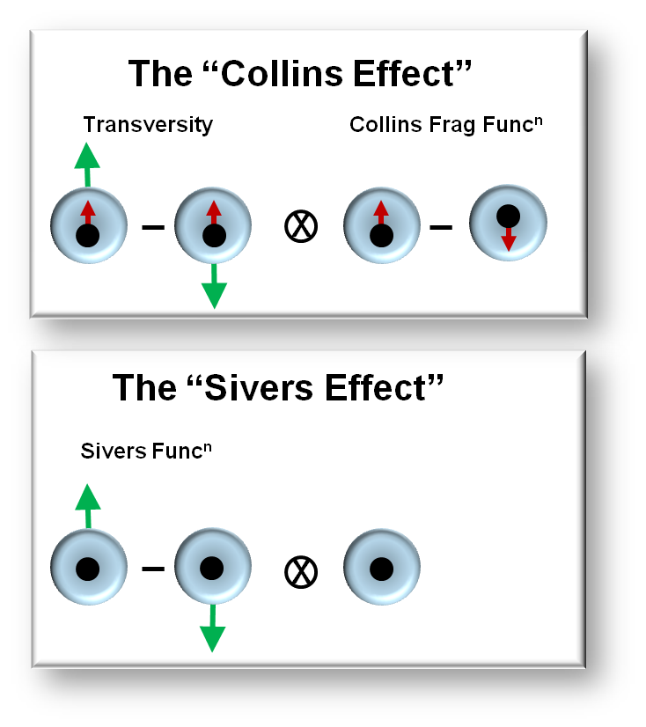
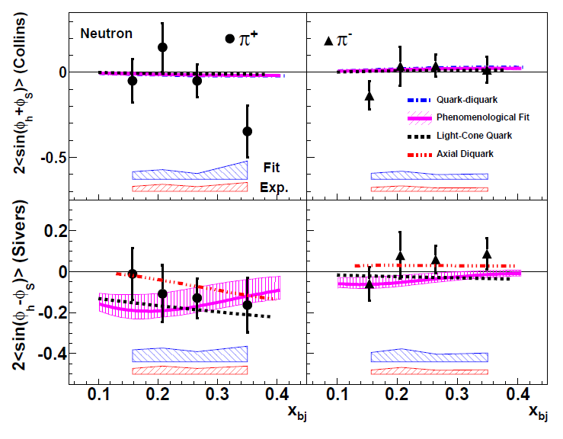
TMDs with SIDIS @ Hall-A 6-GeV
X. Qian et al. (Hall A Collaboration) PRL 107 072003 (2011)
Sizable Collins π⁺ asymmetries at x=0.34?
Hints of violation of Soffer’s inequality?
Data are limited by stat. Needs more precise data!
Negative Sivers π⁺ Asymmetry
Consistent with HERMES/COMPASS
Independent demonstration of negative d quark Sivers function.
Blue band: model (fitting) uncertainties
Red band: other systematic uncertainties

Slide 9
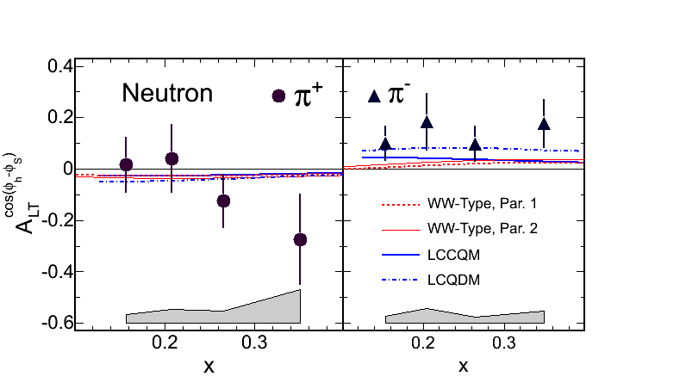
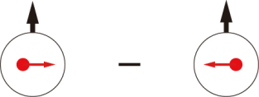
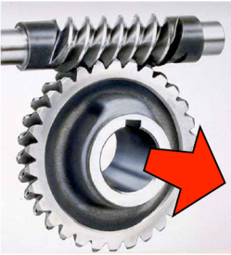
TMDs with SIDIS @ Hall-A 6-GeV
Worm-Gear g_{1T} Access:
Dominated by real part of interference between L=0 (S) and L=1 (P) states
Imaginary part -> Sivers effect
(Measured by COMPASS and HERMES on p and D targets)
g_{1T} =
Huang, et. al. (Hall A Collaboration)
PRL. 108, 052001 (2012)
E06-010 - First data on effectively neutron target
Consistent with models in signs
Suggest larger asymmetry, possible interpretations:
Larger quark spin-orbital interference
different P_{T} dependence
larger subleading-twist effects

Slide 10
Precision Study of TMDs with SoLID+11 GeV
Explorations:
HERMES, COMPASS, RHIC-spin, Jlab-6GeV,…
From exploration to precision study
JLab12: valence region; EIC: sea and gluons
Transversity: fundamental PDFs, tensor charge
TMDs: 3-d momentum structure of the nucleon
→ information on quark orbital angular momentum
→ information on QCD dynamics
Multi-dimensional mapping of TMDs
Precision → high statistics
high luminosity and large acceptance
SoLID

Slide 11
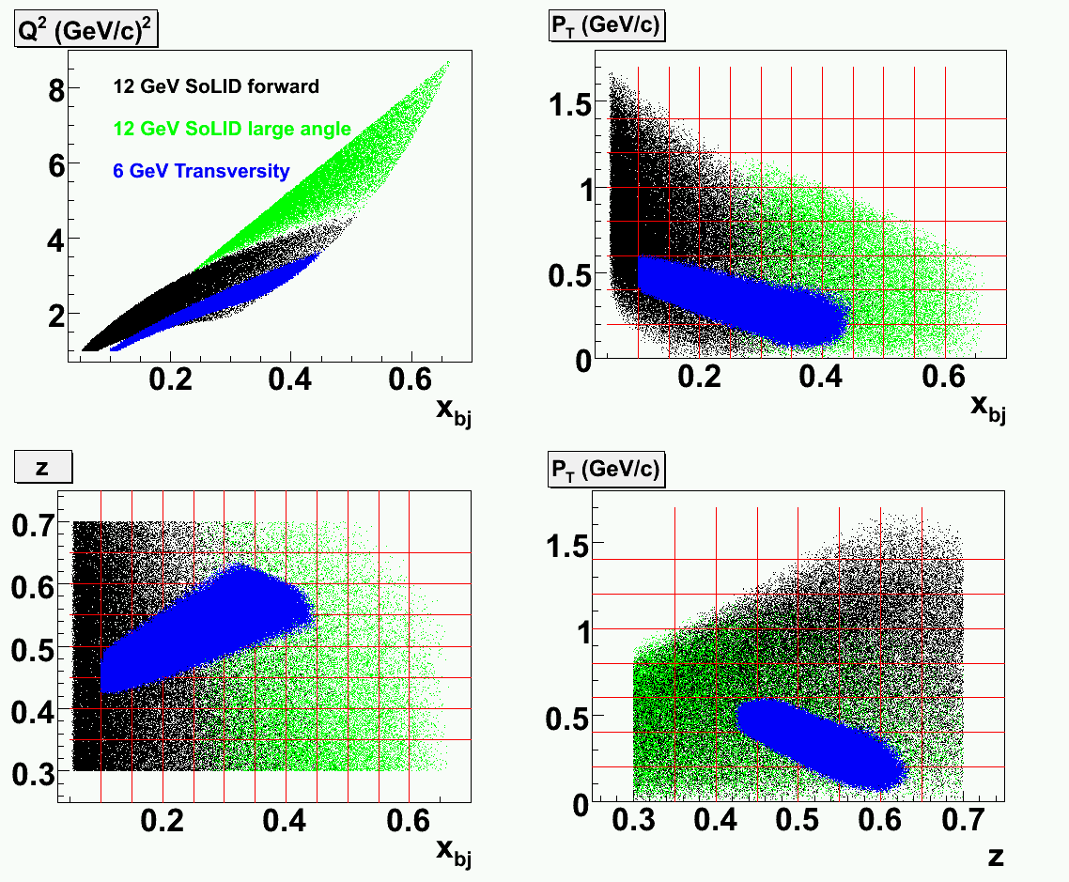
SoLID-SIDIS Phase Space Coverage
Natural extension of E06-010
Much wider phase space
Both transverse and
longitudinal polarized target

Slide 12
About SoLID
SoLID: Solenoidal Large Intensity Device
High Intensity (10³⁷ ~ 10³⁹ cm⁻²s⁻¹) and Large Acceptance
Approved SIDIS Programs:
→ E12-10-006 (A), SIDIS with Transversely Polarized He3, 90 days
→ E12-11-007 (A), SIDIS with Longitudinally Polarized He3, 35 days
→ E12-11-108 (A), SIDIS with Polarized Proton, 120 days
→ and bonus runs ...
OtherPhysics Programs:
Parity Violation Deep Inelastic Scattering (PVDIS): E12-10-007 (169 days, A)
J/ψ : Near Threshold Electroproduction of J/ψ at 11 GeV: E12-12-006 (60 days, A-)
(new LOIs & Proposals) Generalized Parton Distributions (GPDs):
polarized-proton/neutron DVCS, Doubly DVCS, TCS, etc
more

Slide 13
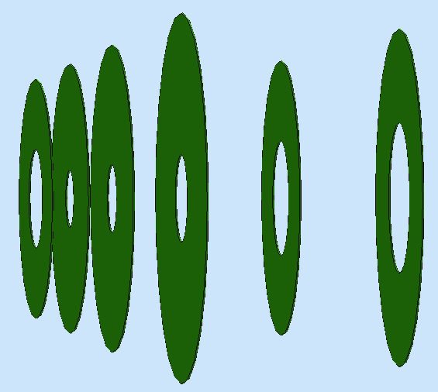
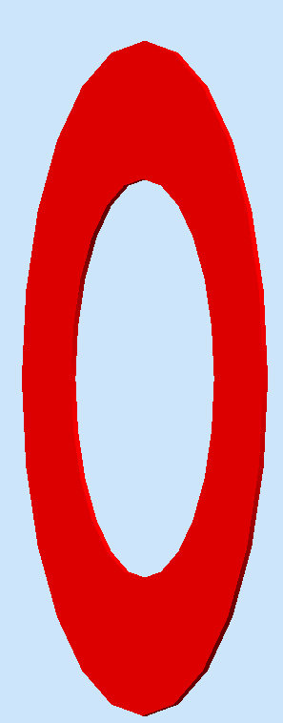
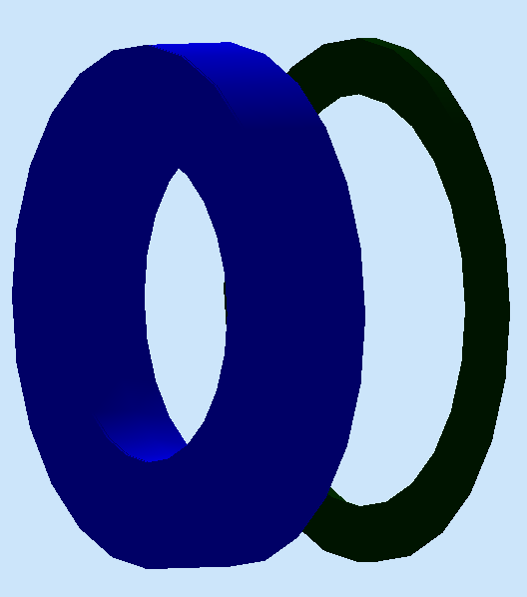
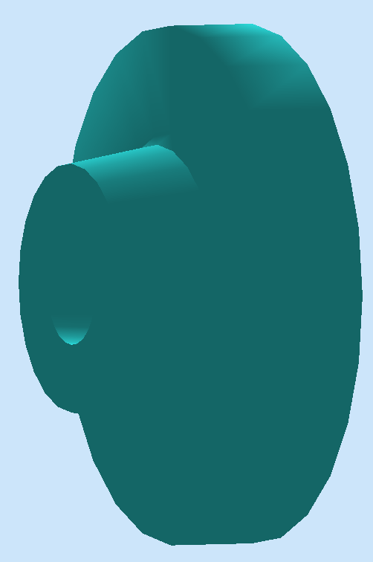
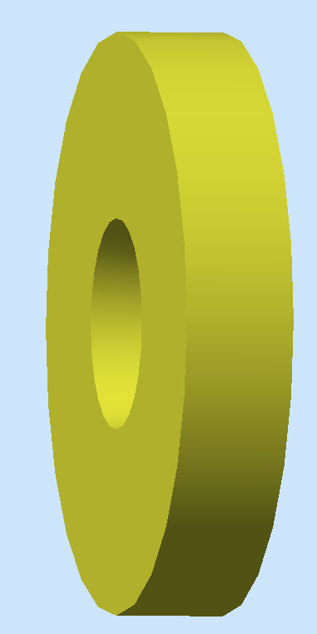

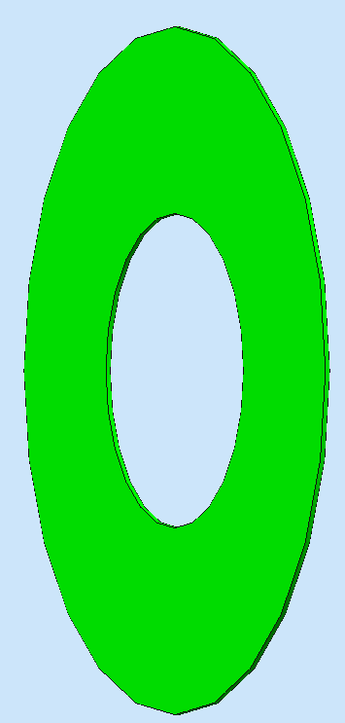
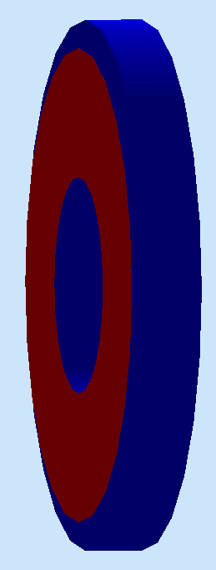
About SoLID
High Intensity (10³⁷ ~ 10³⁹ cm⁻²s⁻¹) and Large Acceptance
Newly developed detector techniques, fast electronics and data acquisition.
Sophesticated MC simulation and analysis software developments
6xGEMs LASPD LAEC LGC HGC FASPD MRPC FAEC
Notes:
We aim to build an advanced device which has high intensity and also have very large acceptance.
So they requires us to take advantage of new detector techniques, very faster electronics and DAQ system. We also need a close-to-realistic simulation tool for us to evaluate the experimental conditions and infrastructure requirements, such as the overall rate, background situation and radiation distribution. Besides, analysis software developments, for example, the tracking reconstruction of GEMs in strong magnetic field is also very important.
I took out individual detectors from the CLEO-II magnet as demonstration. There are two basic solid setups, and some of the detectors, like LGC and EC, can be shared in between two setups. Other infrastructures like targets, collimators and supporting structure are not shown here.
For PVDIS, we use the baffle, which contains 12 layers of thick lead plate to block most of neutral particles and heavier charged particle while only preserve high energy electronics. 4 layers of GEMs provide the tracking information, and Light Gas Cherenkov and electromagnetic calorimeter or EC will be used for triggering, particle identification and energy measurements.
For SIDIS and J/Psi, 6 GEM plates will be used for the tracking at large angle and at forward angle. At large angle, we use Scintillator-pad Detector (or SPD) to reject neutral particles and measure time, and EC to perform the PID. The electron trigger is given by the coincidence between SPD and EC. At forward angle, Light gas Cherenkov will provide the e/pi separation, heavy Cherenkov detectors for the pi/K separation. Multi-gap resistant plate chamber and forward angle SPD will provide timing measurement and reject neutral particles, most importantly, photons. Forward angle EC will provide PID. LGC+MRPC+EC will be used for electron triggers, EC itself can also provide hadron triggers.
There are a lot of activities going on for the Pre-R&D, R&D and MC simulation for each detector. We are going to develop prototypes of LGC at Temple and Heavy Gas Cherenkov at Duke.
In the next few slides I will give you updates for the magnet, GEMs, MRPC, EC, and SPD.

Slide 14
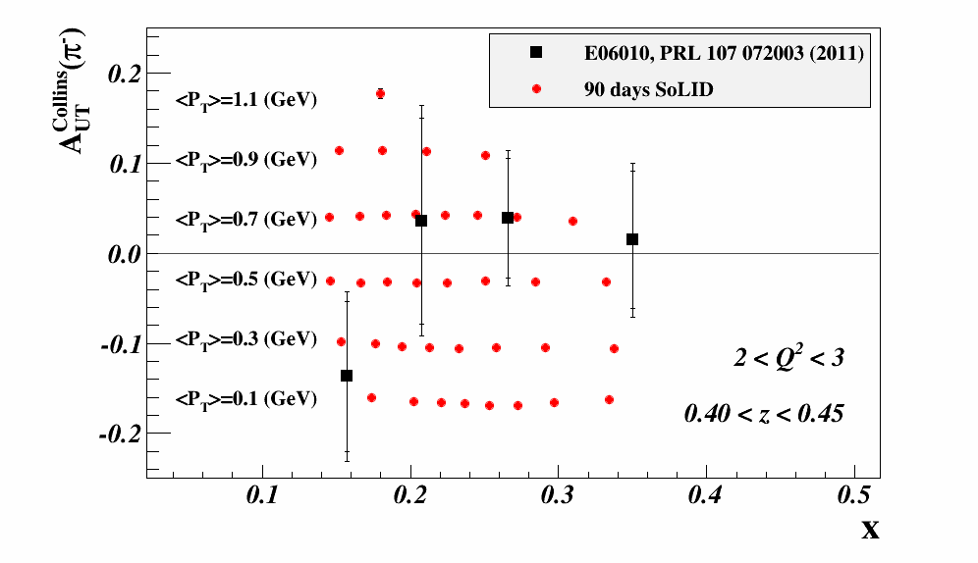
SoLID-SIDIS
SIDIS: 4-D (x, pt, Q2, z) probe of nucleon transverse momentum distribution (TMD)
SoLID-SIDIS studies TMDs with extensive coverage and resolutions (48 Q-z bins)
One Typical Bin to show the good statistics
> 1400 data points!

Slide 15
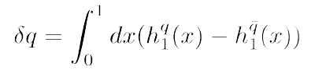
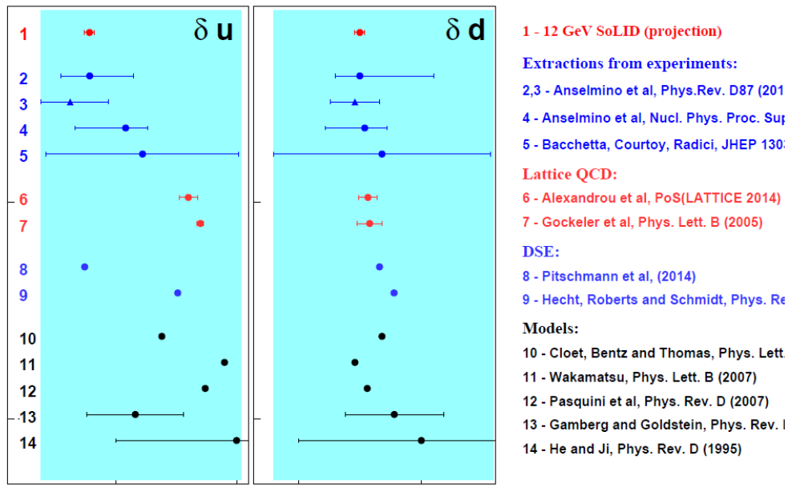
Transversity to Tensor Charge
Tensor Change: 0th moment of transversity
Fundamental quantity
Beyond Standard model searches:
parameters depend on precision of tensor charge
Global model fits to experiments (SIDIS and e+e-)

Slide 16
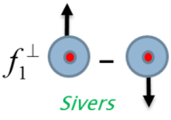
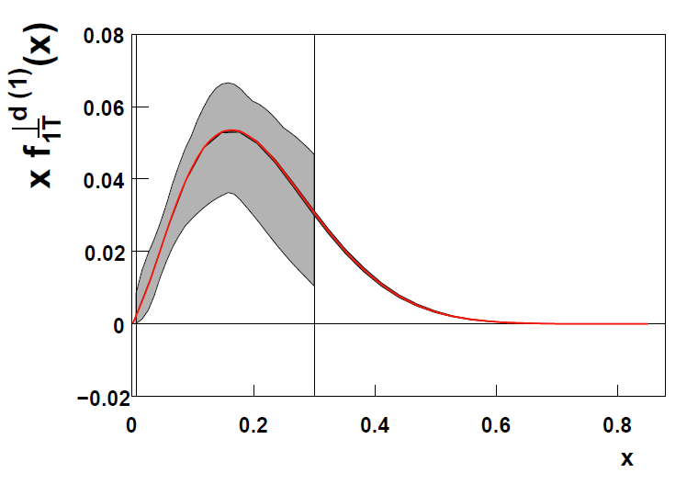
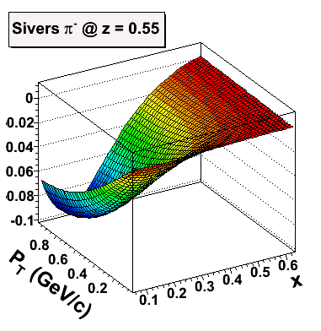
Sivers Function
The distribution of unpolarised parton in a transversely polarized neutron
Sign change between SIDIS and Drell-Yan
Significant Improvement in the valence quark (high-x) region
Future EIC
Multi Dimensional Probe
With future SoLID-SIDIS data
Illustrated in a model fit (from A. Prokudin)

Slide 17
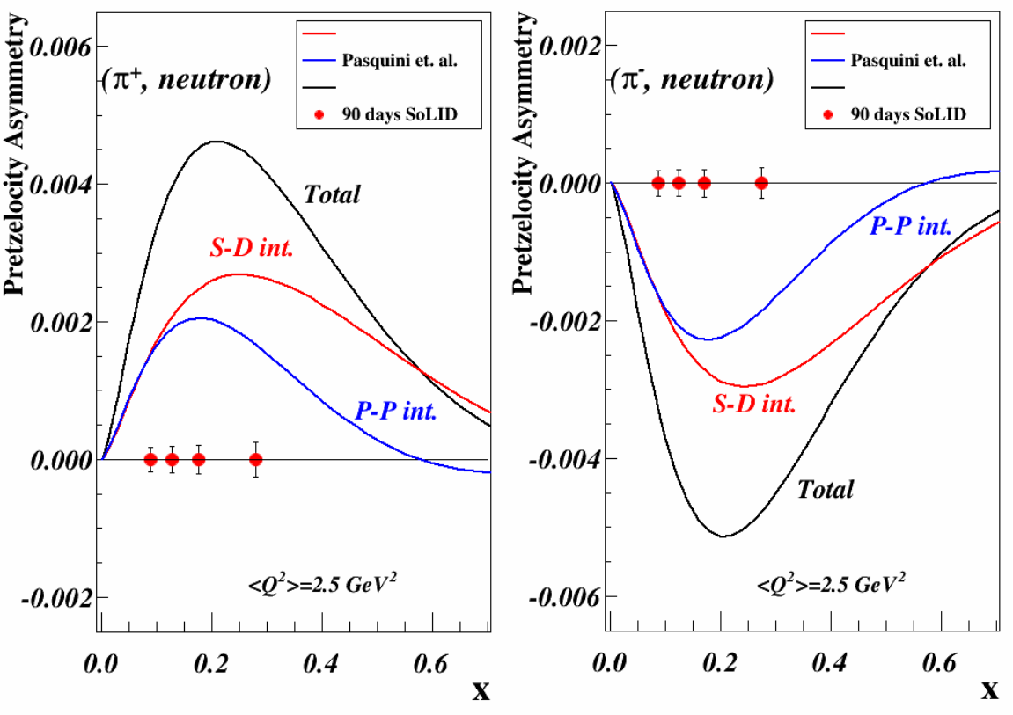
Pretzelocity & Worm-Gear
Access the orbital angular momentum (OAM) of quarks and gluons with transverse n/p
Pretzelocity: L=0 and L=2 interference (S-D int.)
L=1 and L=-1 interference (P-P Int)
Worm-Gear: L=0 and L=1 Interference.

Slide 18
Quick Summary
SIDIS Summary:
TMDs provide plentiful 3D information of the nuclear structure.
TMDs can be probed via SIDIS on polarized targets.
Hall-A 6GeV results showed the power of SIDIS on TMD study
New SoLID-SIDIS experiments aims to perform 4-D precise measurements of TMDs
SoLID Summary:
Take advantage of latest detector and electronics techniques
Active MC simulation, software developments and Pre-CDR & Prototyping
SoLID Timeline:
CLEO-II magnet has been requested and will be transported in 2017
Pre-conceptual Design Report has been submitted in 2014
Director review in Feb. 2015
Planning to move forward (DOE Science Review)

Slide 19
Unified View of Nucleon Structure
Wigner distributions (Belitsky, Ji, Yuan) (or GTMDs)
5D
(X. Ji, D. Mueller, A. Radyushkin)
3D
1D
Explore GPDs in SoLID:
→ DVCS with transverse and longitudinal polarized proton and neutrons
→ Doubly-DVCS, DVMP, Timelike DVCS ...

Slide 20
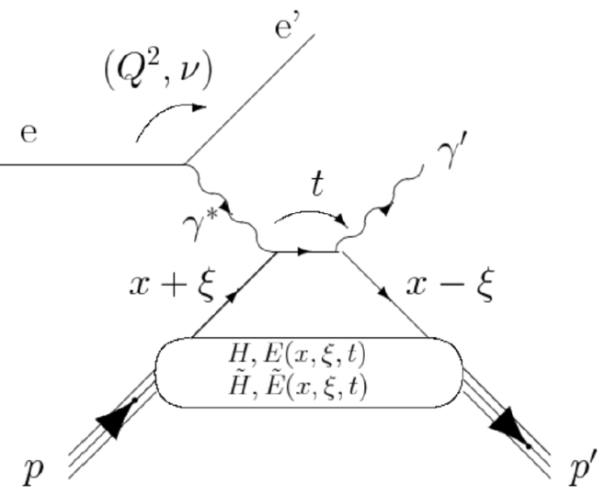
GPD Study @ SoLID
Generalized Parton Distributions (GPD):
Encode Information of the parton distribution in both the transverse plane and longitudinal direction.
Four GPDs for quarks or gluons:
Connect to FF & PDFs: e.g.
X → Longitudinal quark momentum fraction (not experimental accessible)
ξ → Longitudinal momentum transfer. In Bjorken limit:
ξ = x_{B}/(2-x_{B})
t → Total squared momentum transfer to the nucleon:
t = (P-P’)²
Angular Momentum Sum Rule:
(X. Ji, PRL 78, 610 (1997)

Slide 21
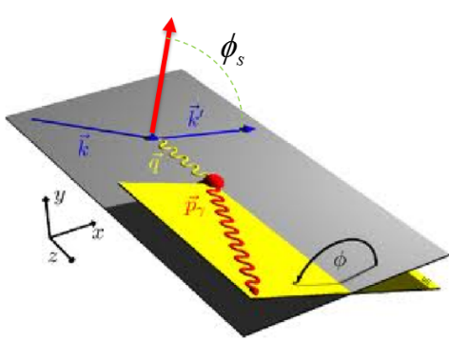
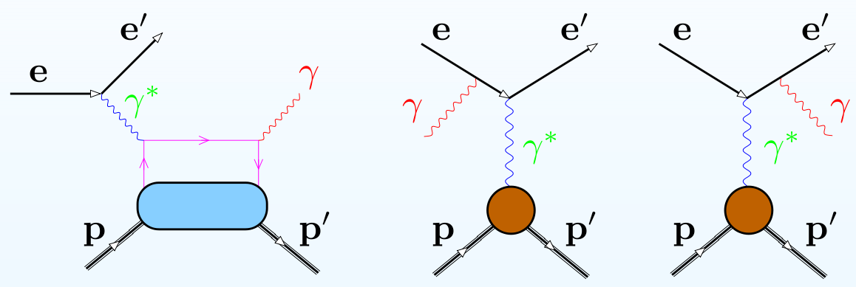
GPD Study @ SoLID
Deeply Virtual Compton Scattering (DVCS):
DVCS
BH
Can access GPDs via DVCS by measuring the Ф dependence of DVCS & Interference Terms
Interference-Term
from Nucleon FF, F₁ & F₂
Compton Form Factor (CFF): Re(H) Im(H)
(similarly for other three)
CFFs access GPDs at x=ξ
In the asymmetry:

Slide 22
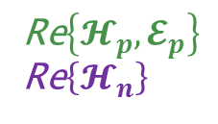
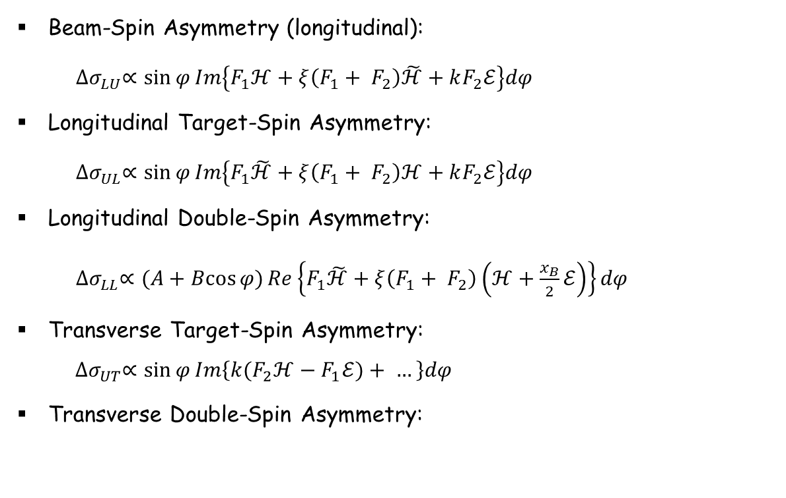
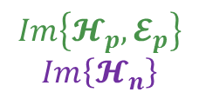
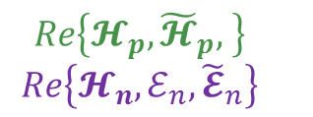
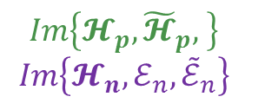
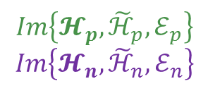
GPD Study @ SoLID
DVCS with polarized electron beam and targets:
Beam-Spin Asymmetry (longitudinal):
${∆σ}_{LU}∝\sin{φ}Im\left\{F_{1}ℋ+ξ\left(F_{1}+ F_{2}\right)\tilde{ℋ}+kF_{2}ℰ\right\}dφ$
Longitudinal Target-Spin Asymmetry:
${∆σ}_{UL}∝\sin{φ}Im\left\{F_{1}\tilde{ℋ}+ξ\left(F_{1}+ F_{2}\right)ℋ+kF_{2}ℰ\right\}dφ$
Longitudinal Double-Spin Asymmetry:
${∆σ}_{LL}∝(A+Bcos{φ)}Re\left\{F_{1}\tilde{ℋ}+ξ\left(F_{1}+ F_{2}\right)\left(ℋ+\frac{x_{B}}{2}ℰ\right)\right\}dφ$
Transverse Target-Spin Asymmetry:
$${ ∆σ}_{UT}∝\sin{φ}Im\left\{{k(F}_{2}ℋ−F_{1}ℰ)+ …\right\}dφ$$
Transverse Double-Spin Asymmetry:
$$Im\left\{𝓗_{p}, {\tilde{ℋ}}_{p}, ℰ_{p}\right\}$$
$$Im\left\{𝓗_{n}, {\tilde{ℋ}}_{n}, ℰ_{n}\right\}$$
$$Im\left\{𝓗_{p}, {\tilde{𝓗}}_{p}, \right\}$$
$$Im\left\{𝓗_{n},ℰ_{n},{\tilde{ℰ}}_{n}\right\}$$
$$Re\left\{𝓗_{p}, {\tilde{𝓗}}_{p}, \right\}$$
$$Re\left\{𝓗_{n},ℰ_{n},{\tilde{𝓔}}_{n}\right\}$$
$$Im\left\{𝓗_{p}, 𝓔_{p}\right\}$$
$$Im\left\{𝓗_{n}\right\}$$
Re$\left\{𝓗_{p}, 𝓔_{p}\right\}$
Re$\left\{𝓗_{n}\right\}$
??? Needed to be added here

Slide 23
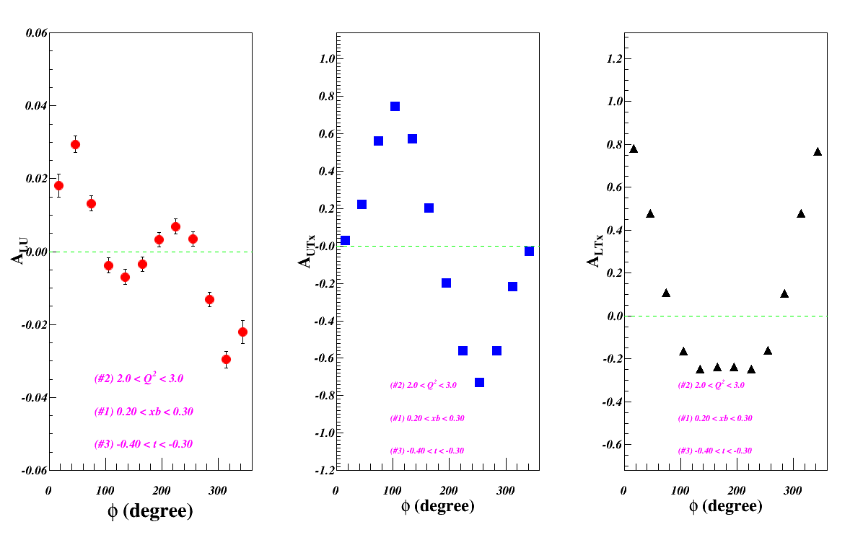
GPD Study @ SoLID
DVCS with polarized neutron/proton with SoLID-SIDIS setup: (new LOIs in 2015)
Asymmetry Projections:
Target Luminosity:
1x10³⁶ cm⁻²s⁻¹, He3, 60% polarization (3% errors), with 15uA beam
1x10³⁵ cm⁻²s⁻¹, NH3, 90% polarization (3% errors), with 100nA beam
Beam: 8.8 GeV and 11 GeV, Longitudinally Polarized
Acceptance: 1<Q²<8 GeV² , 8º<θ<25º, 0º<Φ<360º
Assuming in the run group with SoLID-SIDIS
for Trans. Pol. Neutron: 11GeV ~ 48days, 8.8GeV~21days
Statistics Projection
~ 100 bins in
(Q2, x, t)

Slide 24
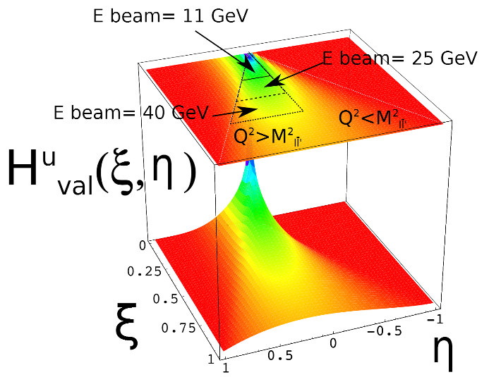
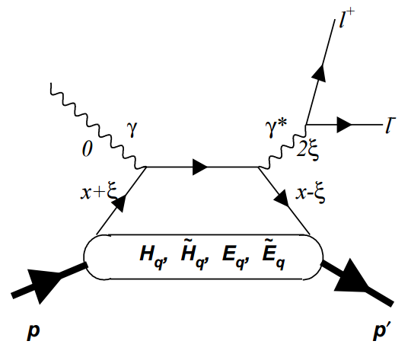
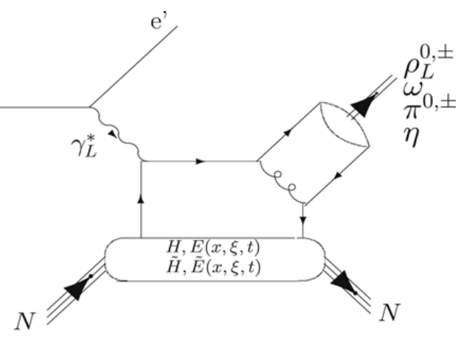
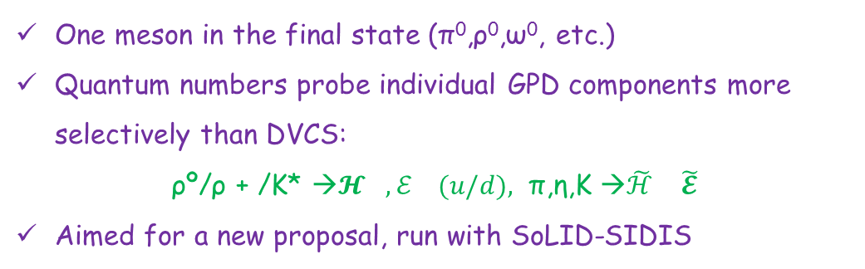
GPD Study @ SoLID
Double-DVCS:
A lepton pair in the final state instead of a real photon
Can access GPDs beyond the x=ξ limit
new LOI submited to 2015-PAC and aimed for a proposal to 2016-PAC
Timelike-DVCS:
Inverse of the space-like DVCS
Extract the real part of CFFs
new proposal, run with SoLID-J/Psi
Deep Virtual Meson Production:
One meson in the final state (π⁰,ρ⁰,ω⁰, etc.)
Quantum numbers probe individual GPD components more selectively than DVCS:
ρº/ρ + /K* →$𝓗_{},ℰ_{} (u/d),$π,η,K →${\tilde{ℋ}}_{}$${\tilde{𝓔}}_{}$
Aimed for a new proposal, run with SoLID-SIDIS

Slide 25
Summary
Understanding the nucleon structure from 1D (PDFs&FF) to 3D (TMDs & GPDs)
SIDIS provides a powerful tool to study TMDs
8 leading twist TMDs to access quark spin & OAM, tensor change, and so on
SoLID-SIDIS programs will perform 4D precise measurements of TMDs
Three A rated experiments, two newly approved “bonus” experiments, and more …
With the features of high luminosity and large acceptance, SoLID can explore a wide range of physics topics:
SIDIS, PVDIS, J/Psi, GPD, and more …
With the similar SoLID-SIDIS setup, we can also study GPDs via DVCS and etc.
Three Letter-of-Intents and one proposal will be submitted in this PAC.
SoLID - A strong and still expending collaboration:
200+ physicists, 50+ institutions and significant international contributions ...
Welcome to join the SoLID collaboration and explore more physics programs

Slide 26
Backup Slides

Slide 27
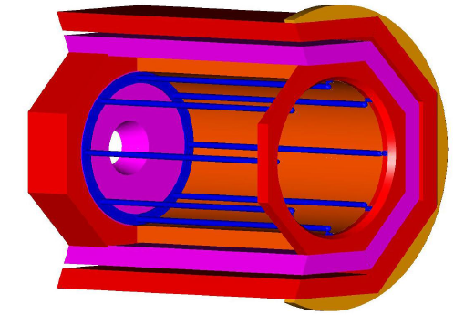
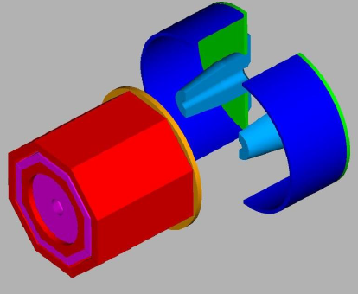
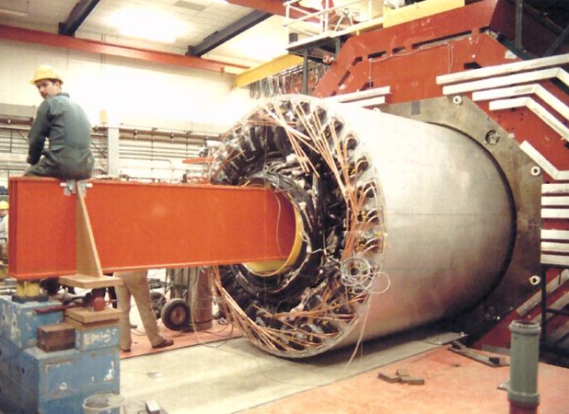
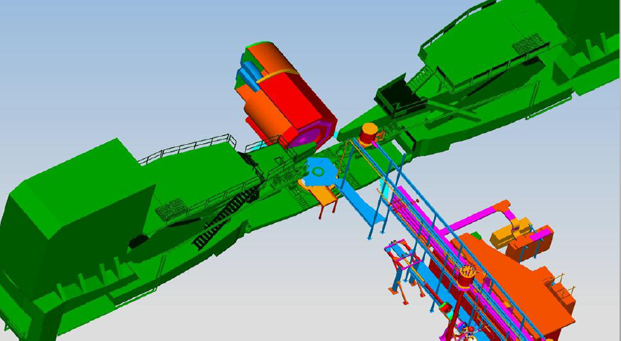
Magnet
CLEO-II Solenoid Magnet: from Cornell Univ.
Goals:
→Acceptance: Φ: 2π, θ: 8º-24º (SIDIS), 22º-35º (PVDIS),
P: 1.0 – 7.0 GeV/c,
→ Resolution: δP/P ~ 2% (requires 0.1 mm tracking resolution)
→ Fringe field at the front end < 5 Gaus
Status:
→ CLEO-II magnet formally repqested and agreed in 2013:
Built in 1989 and operated until 2008, uniform central field at 1.5 T,
Inner radius 2.9 m, coil radius 3.1 m and coil length 3.5 m
→ Site visit in 2014, disasembly in 2015 and plan transportation in 2017
→ Design of supporting structures and mounting system at JLab
CLEO in Hall-A
CLEO at Cornell
Notes:
We need a solenoid magnet that have full 2pi coverage on phi angle, large theta angle range, and wide momentum acceptance with 2% resolution. It is also very important to have small fringe field at the front end where the polarized targets can function normally.
The CLEO-II magnet basically meets our requirements. It was built by Cornel Unit in 1989 and can provide uniform central field up to 1.5T, and its inner radius is 2.9 meter and the coil length is 3.5m.
It operated until 2008 and has been well maintained since then, which is very good for us. We submitted our formal request in 2013 and agreed. Our lab scientists and engineers visited Cornell in this summer and worked with their staffs for the disassembly and transportation plan. Basically, we should have the magnet at Jlab roughly around 2017.
At our site, our engineers have been helping us on the designs of supporting structure and detector mounting frames, and look for the options of placing SoLID with HRSs.
It is a very important progress.

Slide 28
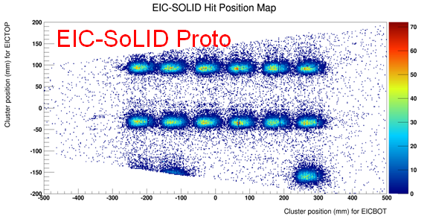
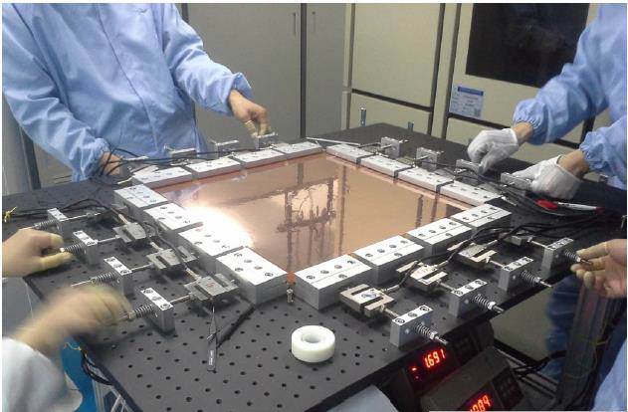
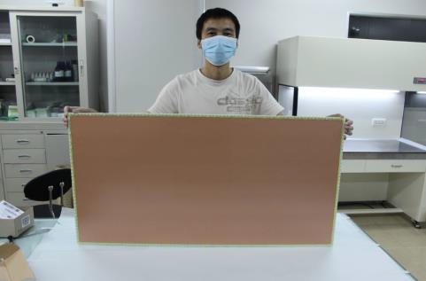
Detectors
GEM:
→ 6 planes (SIDIS/JPsi), area~37 m² (165K outputs),
→work in high rate and high radiation environment.
→tracking eff.>90%, radius resolution ~ 0.1 mm,
Status:
UVa: First full size prototype assembled, and beam test at Fermi Lab Oct 2013
China: CIAE/USTC/Tsinghua/LZU)
30x30 cm prototype constructed and readout tested, and now moving to 100cmx50cm
Gem foil production facility under development at CIAE
Continue on read-out electronics desgin and test
30cmx30cm GEM prototype
100cmx50cm GEM foil
Notes:
The GEM plate is an advanced tracking detector that not only can handle very high rate, but also can work in the strong magnetic field. We need 5 planes for PVDIS and six planes for SIDIS and J/Psi. The design goals of the GEMs are to provide 90% tracking efficiency and 0.1mm resolution on the radius direction.
The GEM detector development is very active at UVa as well as at several institutes in China. Nilangas group at UVa has built a very large GEM prototype and had the beam test at Fermi Lab in Oct. 2013.
Our Chinese collaborators are also very actively developing their GEM detectors. So far a 30x30 cm2 prototype has been constructed and tested. And now they are moving to the 100cm x 50cm prototype construction. A GEM foil production facility is under development at CIAE. And our colleagues are also working very hard on the read-out electronics design and test.

Slide 29
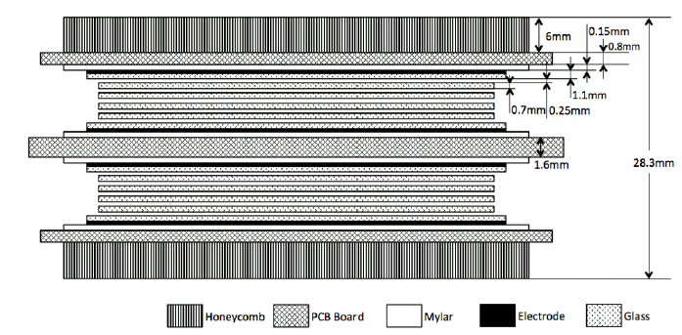


Detectors
Multi-gap Resistive Plate Chamber:
Goals:
→ 50 super-modules, each contains 3 modules,
1650 strips and 3300 output channels.
→ Timing resolution < 100ps
→ Works at high rate up to 10 KHz/cm2
→ Photon suppression > 10:1
→ π/k separation up to 2.5GeV/c
Status:
→ Prototype Developed at Tsinghua
→ Beam test at Hall-A in 2012
→ New facility for mass production
→ Read-out electronics design
Notes:
Another big contribution from our Chinese collaborators is the MRPC, multi-gap resistive plate chambers. Tsinghua Univ has a lot of experience to build such device for LHCb and us. Duke Univ is helping them on the detector construction and simulation. Rutgers is helping on the read-out system.
MRPC will be used for SoLID and J/Psi. It will be placed in between FASPD and FAEC to perform very high precision time measure and reject neutral particles. The MRPC will consisted of 1650 individual strips and over 3000 output channels. It can provide better than 100ps time resolution and easily deal with data rate up to 10KHz/cm2. The detector can provide 10:1 photon suppression and together with FASPD, we can suppress most of photon background. Utilizing the high precision time information, we can separate pions and kaons upto 2.5 GeV/c from their Time of Fly spectra.
Tsinghua has built a prototype and successfully ran a beam test in Hall-A in 2012 during the G2P experiment. The plot is the beam test results which show that it is fairly easy to obtain great time resolution while maintaining high detection efficiency. The Pre-Amp and TDC are also under developments.

Slide 30




Detectors
Electromagnetic Calorimeters (EC):
Goals:
→ Shashlyk sampling calorimeters
→ 1800 modules (2 R.L.) for PreShower, 1800 modules (18 R.L) for Shower
→ electron eff.>90%, E-Resolution~10%/√E,
π suppresion > 50:1
→ Rad. Hard (<20% descreasing after 400K Rad)
Status:
→ Sophesticated Geant Simulation
→ Active Pre-R&D at UVa and Jlab
→ Sample&PMT tests and Pre-Amp design
Notes:
The electromagnetic calorimeters or EC is one of the most important detectors for both online electron and pion triggering, offline PID and energy measurements. The best candidate for the EC is the Shashlyk sampling calorimeter which is composed of lead plates, scintillator pad and scintillating fibers. We design our EC to be easily re-arranged between the PVDIS setup and SIDIS setup. As you can see from the table, PVDIS EC need a total area of 18.3 m2 for the angular coverage. For SIDIS, the total area need at both the forward angle and the large angle is close to the PVDIS EC, which means that we can just re-arrange the EC blocks to form two EC planes if PVDIS ran first, and vice versa. Of cause, these design requires removable read-out electronics.
Anyhow, we need 1800 modules for the preshower and shower, respectively. The design goal is to have electron efficiency to be above 90% and energy resolution of 10% per square root of GeV. The pion suppression would be better than 50:1. Of cause, the detector has to be radiation hard.

Slide 31



Detectors
Scintillating Pedal Detectors (SPD):
Goals:
→ For SIDIS/JPsi only
→ Two planes (in front of LAEC and FAEC):
LASPD: 60 modules, 5 mm or thicker, photon rej. 10:1
FASPD: 60 modules x 4 radius, photon rej. 5:1
→ LASPD timing resolution < 150ps
Status:
→ Design and Simulation
→ Pre-R&D at UVa and JLab
Notes:
The scintillating pedal detector or SPD is an important supporting detector for EC to provide photon rejection and time measurements, in particularly at the large-angle side.
For the LA, we will use 60 modules of 5mm thick SPD, and each module cover 6 degrees. The design goal is to have 10:1 photon rejection.
For the FA, 60 modules will be used and each module contains four small paddles. We will use the fiber to guide the light out from each paddle.
To archive the goal of photon rejection, the segmentation of each SPD has been studied with very careful simulation by considering all kinds of background sources. Pre-R&D and simulation have been actively carrying on at both Uva, Duke and Jlab site.

Slide 32

Triggers&DAQ
Triggers:
Estimation based on sophesticated Geant simulation and well-tone physics models
PVDIS: LGC+EC provide electron triggers, 27 KHz/sector, 30 sectors
SIDIS: Coincident trigger between electrons and hardrons within a 30 ns window:
LASPD+LAEC provide electron triggers, 25 KHz
LGC+FASPD+MRPC+FAEC provide electron trigger, 129 KHz
FASPD+MRPC+FAEC provide hardron trigger, 14 MHz
66 KHz + 6 KHz (eDIS)
Read-Out and Data Aquisition System:
→ Use fast electronics to handle the high rates
(FADC, APV25, VETROC, etc.)
→ Read out EC clusters to reduce background
→ Current design can take the trigger rates
60 KHz per sector for PVDIS, and 100 KHz overall for SIDIS
→ Use Level-3 to further reduce the events size
→ Learn new developments from others (e.g. Hall-D)
EC Trigger
Notes:
Next I will give you an update of our current trigger situation which was estimated based on the simulation and physics modules.
For PVDIS, the trigger is provided by the LGC and EC, and the trigger rate for each sector is 27KHz.
For SIDIS, the trigger comes from the coincidence between the electron trigger and pion trigger within 30ns window.
For the LA, SPD and EC can provide 25 KHz single electron triggers.
For the FA, LGC+FASPD+MRPC+FAEC will provide the electron trigger which is about 129 KHz.
The pion hadron trigger is provided by the SPD, MRPC and FAEC and the rate is 14MHz. So the coincidence rate is 66KHz plus 6KHz of real physics rate.
To handle the high rate, we will use the newest electronics for the signal read-out and DAQ, like FADC, APV25 for GEM and VETROC for MRPC, and so on.
We design a read-out algorithm to readout EC signal by clusters which can help us to reduce the background.
Currently, the design can take upto 60KHz per sector for PVDIS and 100KHz overall for SIDIS. We can use the Level-3 farm to further reduce the data size before we record them.
The detector and electronics technologies are developed very fast and many other groups are also working on read-out system that can deal with high rate, like Hall-D, and we can learn from their new developments. I believe our design still can be improved.

